Slide 1




WEB
ENGINEERING
CHAT
APPLICATION
Presented by:
Rashmi Mohan(IT-74)
Sahil Sangtani(IT-78)
Satyam Agrawal(IT-81)
Submitted to:
Dr. Lalit Purohit
Mr. Upendra Singh

Slide 2




Introduction to Real-Time Chat Applications
Significance of Real-Time Communication in Modern Applications

Slide 3

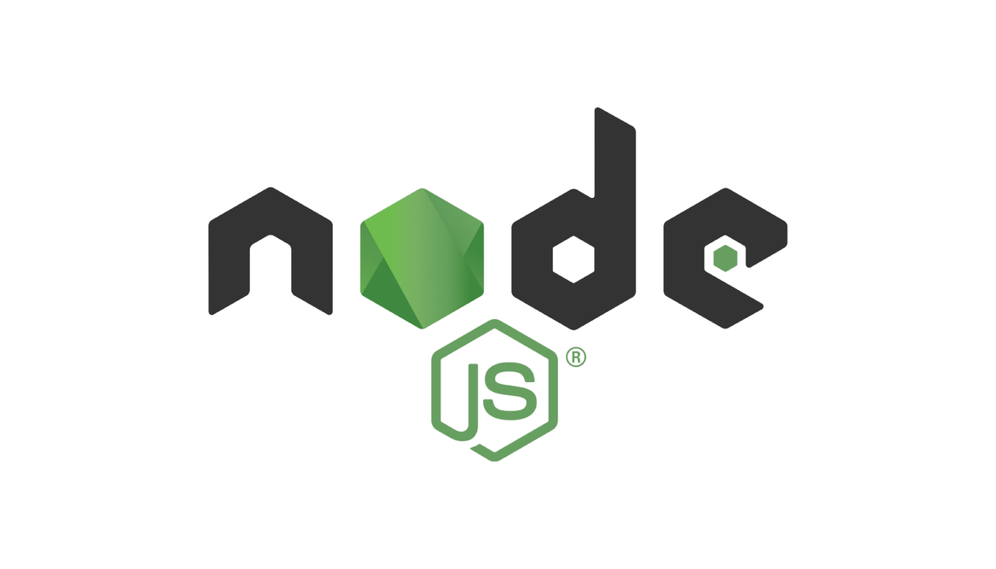


Technologies Used
React
Node.js
Socket.io
MongoDB
React is a free and open-source front-end JavaScript library for building user interfaces based on components.
Node.js is a cross-platform, open-source JavaScript runtime environment and executes JavaScript code outside a web browser.
Socket.IO is an event-driven library for real-time web applications. It enables real-time, bi-directional communication between web clients and servers. I
MongoDB is a database program. Classified as a NoSQL database product, MongoDB utilizes JSON-like documents with optional schemas.

Slide 4
Project TechStack
Breakdown of Frontend and Backend Technologies: React for Frontend, Node.js for Backend
Role of Socket.io in Enabling Real-Time Communication
Importance of MongoDB as a NoSQL Database for Scalable Data Storage
Advantages of Using a Comprehensive Technological Stack for Building Robust Applications

Slide 5






Installing Essential Packages
Package Management in Node.js with npm
Essential Packages for Real-Time Chat App Development
Package's Role in the Development Process
Step-by-Step Installation Procedure Using npm

Slide 6

Setting Up the Backend
Express Server Initialization Process
Middleware in Express for Handling Requests
Error Handling Mechanisms in Express
Implementation of Environment Variables with EMV for Enhanced Security

Slide 7



Database Management
Explanation of MongoDB Setup Process: Installation and Configuration
Schema and Model Creation with Mongoose for Structured Data Storage
CRUD Operations (Create, Read, Update, Delete) with MongoDB
Practices for Efficient Database Management in Real-Time Applications

Slide 8





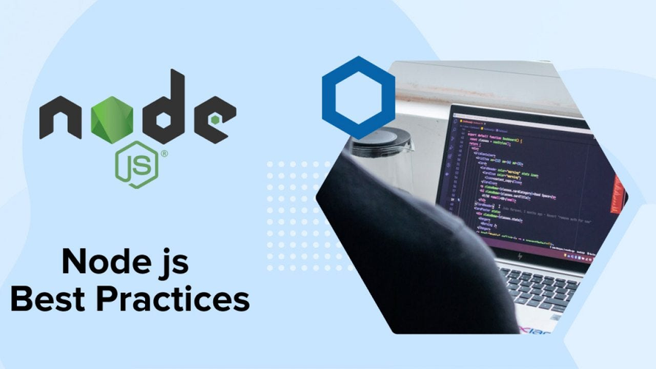
User Authentication
Significance of User Authentication in Real-Time Chat Applications
Role of JWT (JSON Web Tokens) in Secure Authorization
Implementation of bcrypt JS for Secure Password Hashing
Best Practices for User Authentication in Node.js Applications

Slide 9
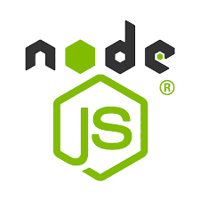
Handling User Authentication (Contd.)
01
02
03
04
.
Implementation of Controller Functions for User Input Validation
Overview of Error Handling Mechanisms to Handle Authentication Error
Importance of User Authentication for Securing User Data and Enhancing User Experience
Creation of Login, Sign-Up, and Logout Functions in Node.js

Slide 10




Real-Time Communication
Introduction to Socket.io for Real-Time Messaging and Event-Based Communication
Schema and Model Design for Managing Messages and Conversations
Integration of Socket.io for Enabling Instant Message Delivery
Importance of Real-Time Communication in Enhancing User Engagement and Experience

Slide 11

Deployment Considerations
Overview of Common Deployment Challenges in Real-Time Chat Applications
Strategies for Production Deployment: Continuous Integration and Continuous Deployment (CI/CD)
Exploration of Containerization Technologies (e.g., Docker) for Efficient Deployment
Importance of Cloud Infrastructure (e.g., AWS, Azure) for Scalability and Reliability

Slide 12
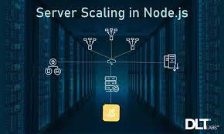
Scalability Considerations
Importance of Scalability in Real-Time Chat Applications
Strategies for Horizontal and Vertical Scaling in Node.js Applications
Discussion on Load Balancing Techniques for Distributing Traffic Effectively
Overview of Caching Mechanisms for Improving Performance and Scalability

Slide 13


Security Measures
Importance of Security in Real-Time Chat Applications
Overview of Common Security Threats (e.g., Cross-Site Scripting, SQL Injection)
Implementation of Security Measures (e.g., HTTPS, Content Security Policy)
Role of Security Audits and Penetration Testing in Ensuring Application Security

Slide 14
Performance Optimization
Importance of Performance Optimization in Real-Time Applications
Strategies for Code Optimization and Minification
Discussion on Client-Side and Server-Side Caching Techniques
Role of Profiling Tools for Identifying Performance Bottlenecks

Slide 15


Continuous Integration and Deployment (CI/CD)
01
02
03
04
Overview of Continuous Integration (CI) and Continuous Deployment (CD)
Pipelines
Implementation of Automated Testing and Deployment Processes
Introduction to CI/CD Tools (e.g., Jenkins, Travis CI)
Benefits of CI/CD in Ensuring Code Quality and Deployment Efficiency

Slide 16
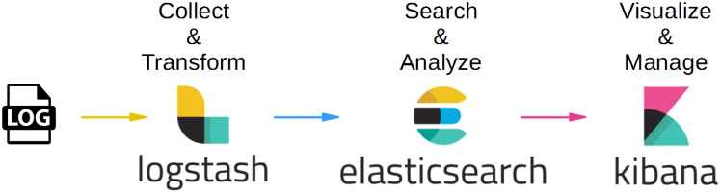
Monitoring and Logging
Importance of Monitoring and Logging in Real-Time Applications
Implementation of Log Management Systems (e.g., ELK Stack)
Overview of Application Performance Monitoring (APM) Tools (e.g., New Relic, Datadog)
Role of Monitoring and Logging in Identifying and Resolving Issues in Real?Time Applications

Slide 17
THANK YOU
For watching this presentation

